Slide 1



Quantifying the behaviour of Citizen Scientists reveals the origins of bias in volunteer collected data
Tom August, Richard Fox, David Roy, and Michael Pocock

Slide 2
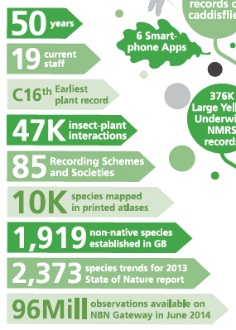
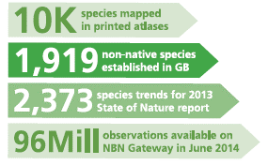
T H E B I O L O G I C A L R E C O R D S C E N T R E
@TomAugust85
The Biological Records Centre has supported citizen science for over 50 years
We work with over 85 recording schemes and societies
The majority of data are ad-hoc

Slide 3
P E O P L E A R E D I F F E R E N T
@TomAugust85
“Measures of observer expertise included in models as a covariate can account for heterogeneity and bias introduced by variable expertise”
- Johnston, A., Fink, D., Hochachka, W.M., Kelling, S., 2017. Methods Ecol. Evol.

Slide 4
Q U A N T I F Y I N G V A R I A T I O N Temporal
@TomAugust85
Activity ratio: The proportion of days on which the volunteer was active in relation to the total days he/she remained linked to the project
Median weekly devoted days: Median number of days a week the recorder make observations. it is only calculated across weeks when recording occurred.
Active day
Inactive day
Active week
Inactive week
Weeks
Days linked to the project
Periodicity: The median number of days elapsed between each pair of sequential active days. This describes captures the regularity with which people record.
Periodicity variation: The standard deviation of the times elapsed between each pair of sequential active days
Ponciano and Brasileiro 2014

Slide 5
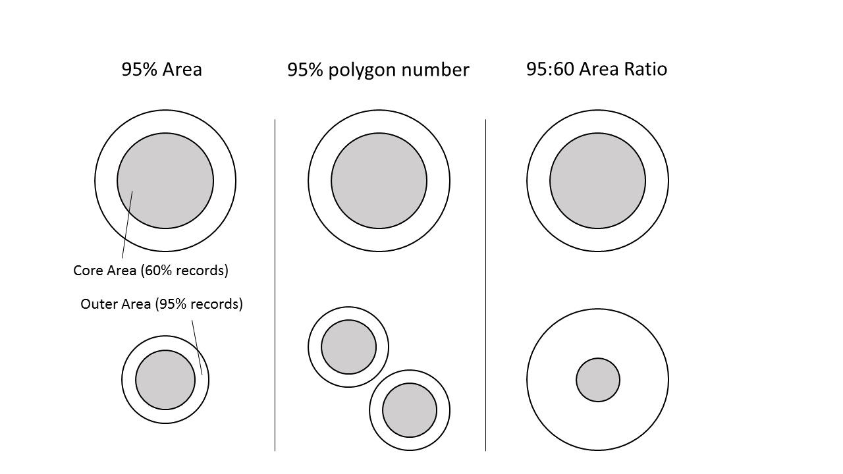
Q U A N T I F Y I N G V A R I A T I O N
Spatial
@TomAugust85
95:60 Area Ratio: This is the ratio between 95% area, and a kernel density polygon fitted to contain 60% of the recorder’s records.
95% Polygon number: This is the count of the number of discrete polygons that make up the 95% area.
95% Area: The area that contains 95% of a recorder's records.

Slide 6
Q U A N T I F Y I N G V A R I A T I O N
Data content
@TomAugust85
Proportion of Taxa Recorded: The number of unique taxa recorded as a proportion of the total number of taxa recorded by all recorders.
Median Rarity Difference: The difference between the median rarity for a recorder and the grand median across all recorders.
P Single Species Lists: The proportion of visits from the recorder.

Slide 7
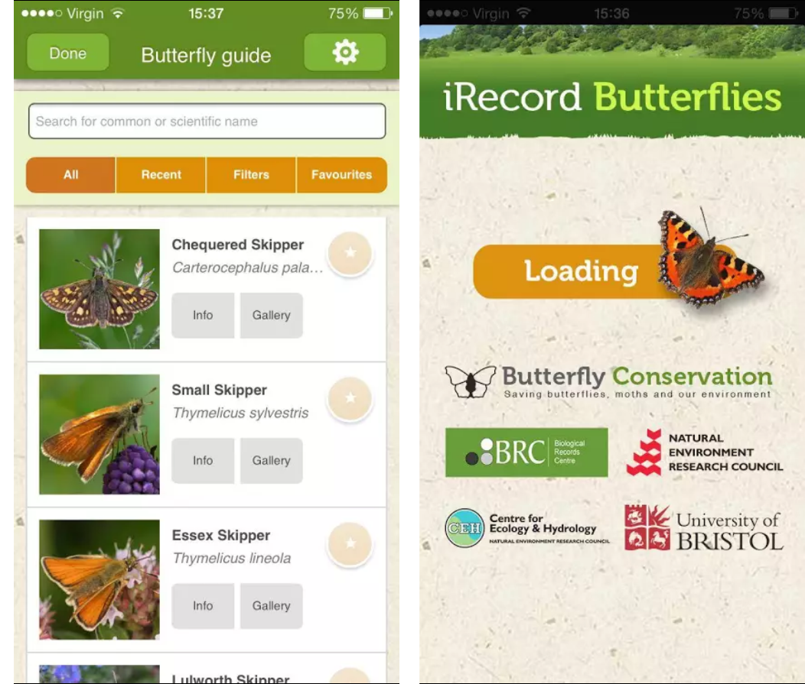
I R E C O R D B U T T E R F L I E S
@TomAugust85
Smartphone app for beginners and experts.
All records are centralised, verified, and used in assess patterns of change.
Data used form 2014-2017
5268 recorders, submitted 169,707 records
1000 recorders active on more than 10 days
Search ‘iRecord Butterflies’ in your app store

Slide 8
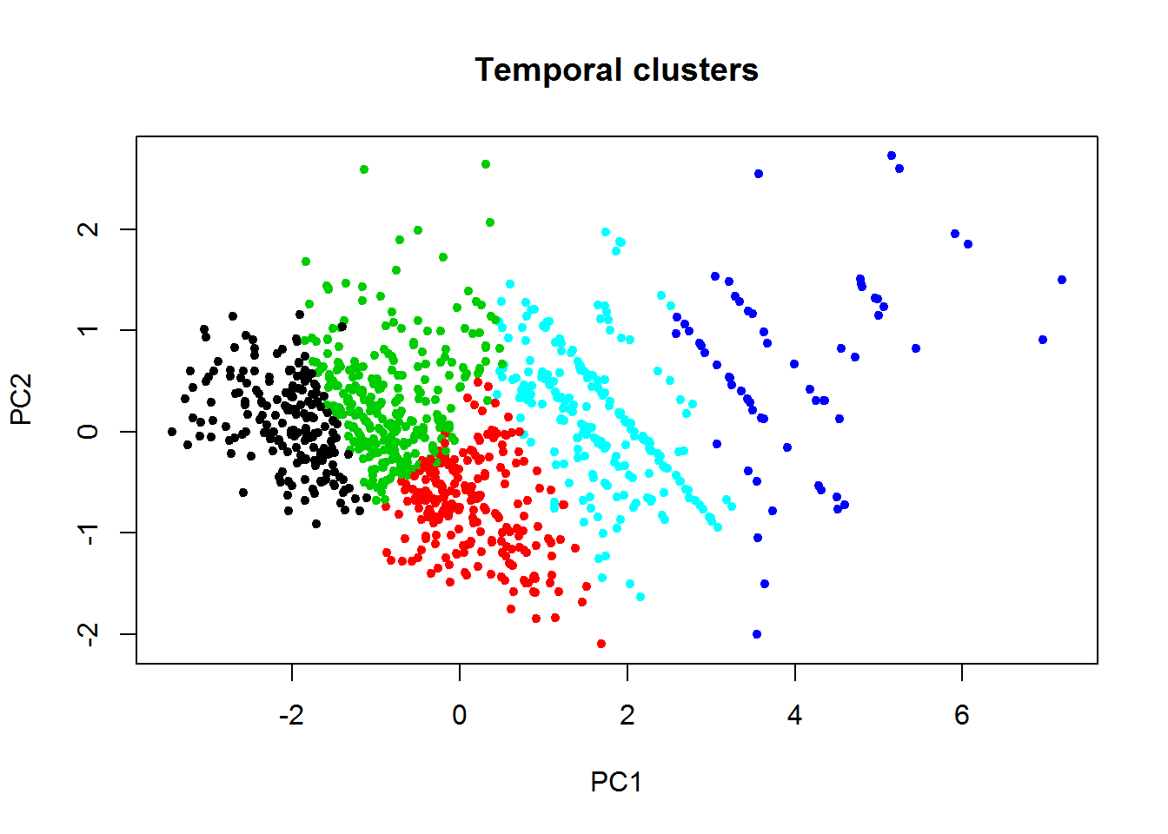
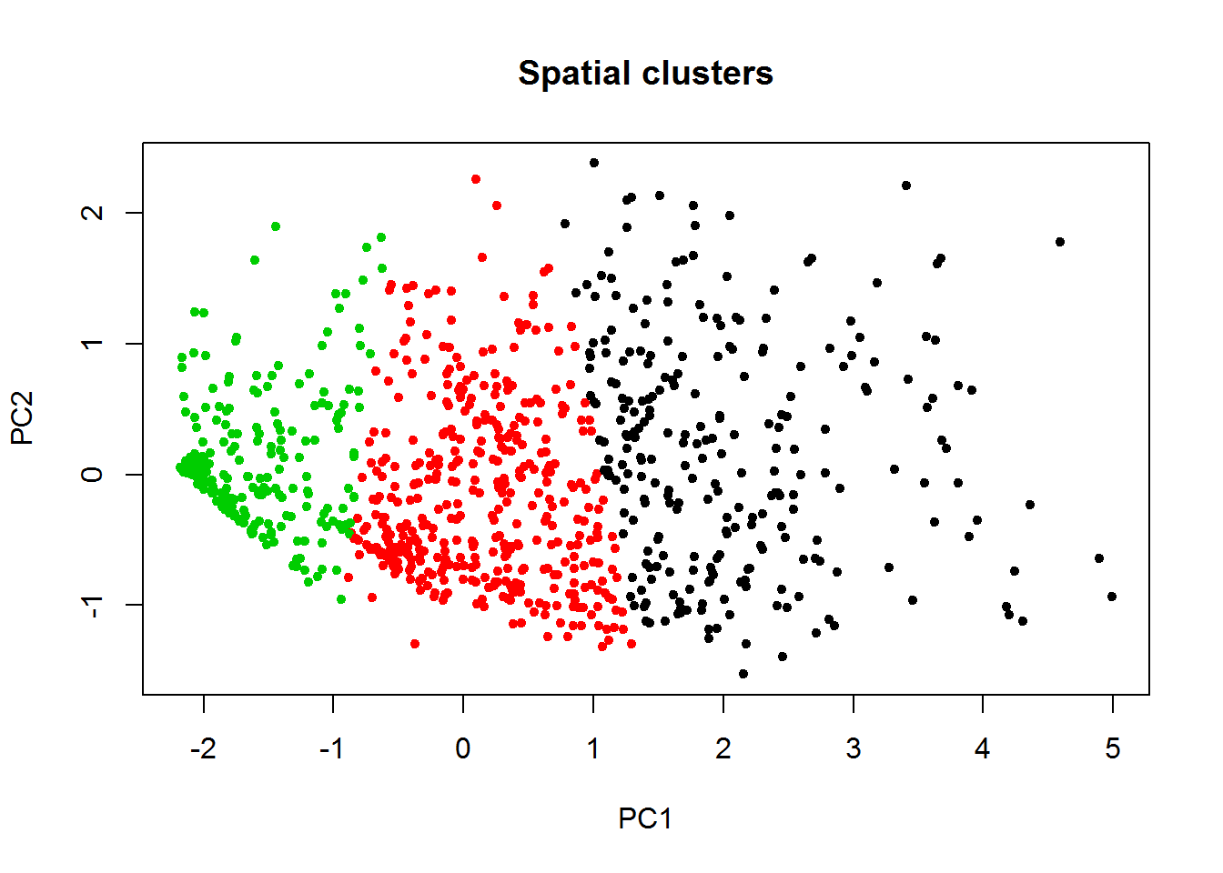
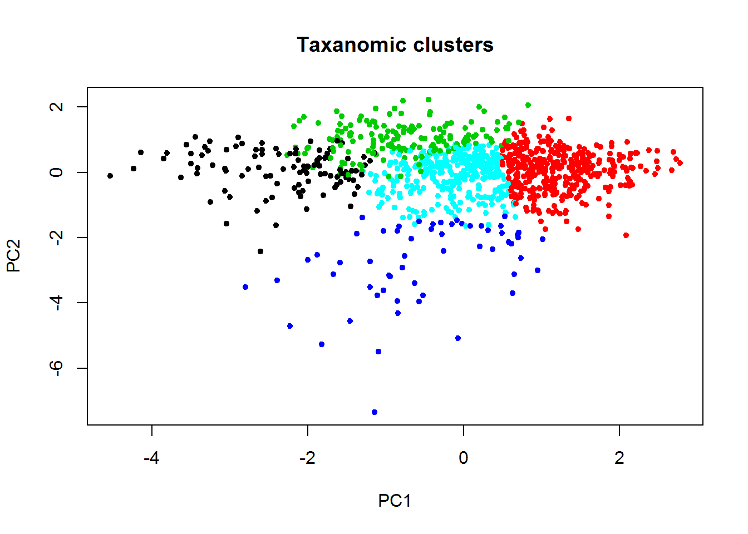
C L U S T E R I N G
@TomAugust85
Temporal
Spatial
Data Content
Each point represents a recorder
K-means clusters are not supported. All silhouette widths are below 0.5 (0.27, 0.41, 0.28). Evidence of clusters in previous studies limited to temporal metrics may result from the inclusion of ‘dabblers’

Slide 9
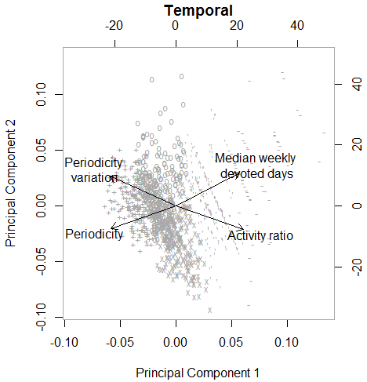
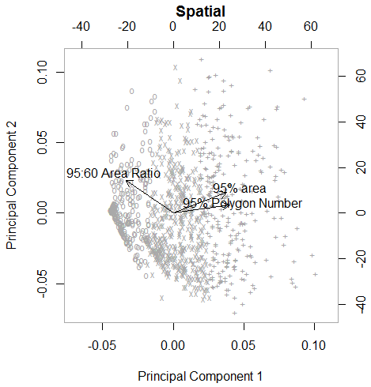
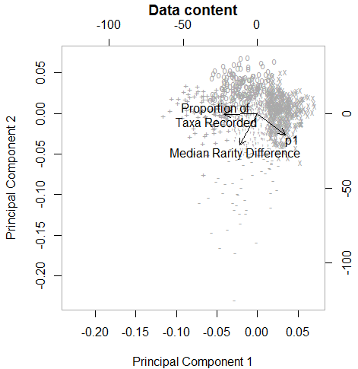
P R I N C I P A L C O M P O N E N T A N A L Y S I S
@TomAugust85
52%
72%
82%
34%
Recording potential: recorders with high recording potential record a large proportion of species, fewer lists of length one and also record more rare species than the average recorder
Recording intensity: individuals with high values record frequently and regularly
Spatial extent: recorders with high spatial extend record over many locations, unevenly
Rarity recording: recorders with a high rarity recording score will tend to preferentially record rarer species, typically on lists of length 1.

Slide 10
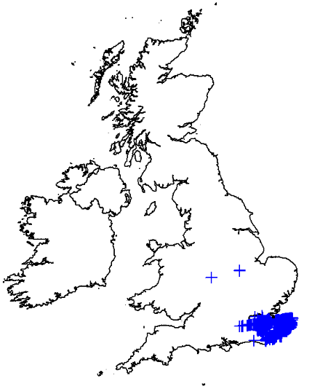
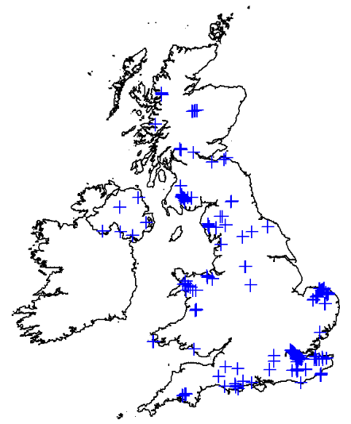
A P P L I C A T I O N S
@TomAugust85
M O D E L S
E N G A G E M E N T
Detectability
Detectability
Recording potential
Rarity Recording
Target individuals for projects relevant to their recording style (e.g. temporal vs spatial).
Identify mechanisms of behavioural change in volunteer recorders.
“Measures of observer expertise included in models as a covariate can account for heterogeneity and bias introduced by variable expertise”
- Johnston, A., Fink, D., Hochachka, W.M., Kelling, S., 2017. Methods Ecol. Evol.

Slide 11
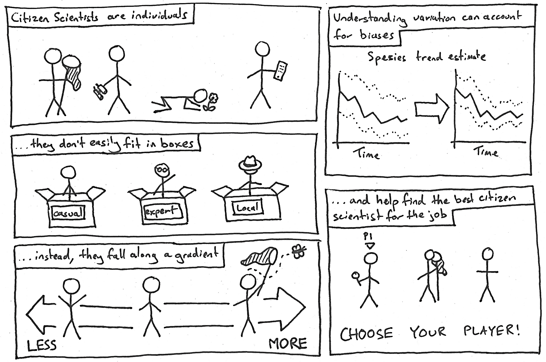
I N C O N C L U S I O N
Thanks to
Nick Isaac, Gary Powney, Charlie Outhwaite, Martin Harvey, Oli Pescott, thousands of butterflies records and tens of thousands of citizens scientists
@TomAugust85 / tomaug@ceh.ac.uk

